Slide 1
Methodologies to Detect microleakage

Slide 2
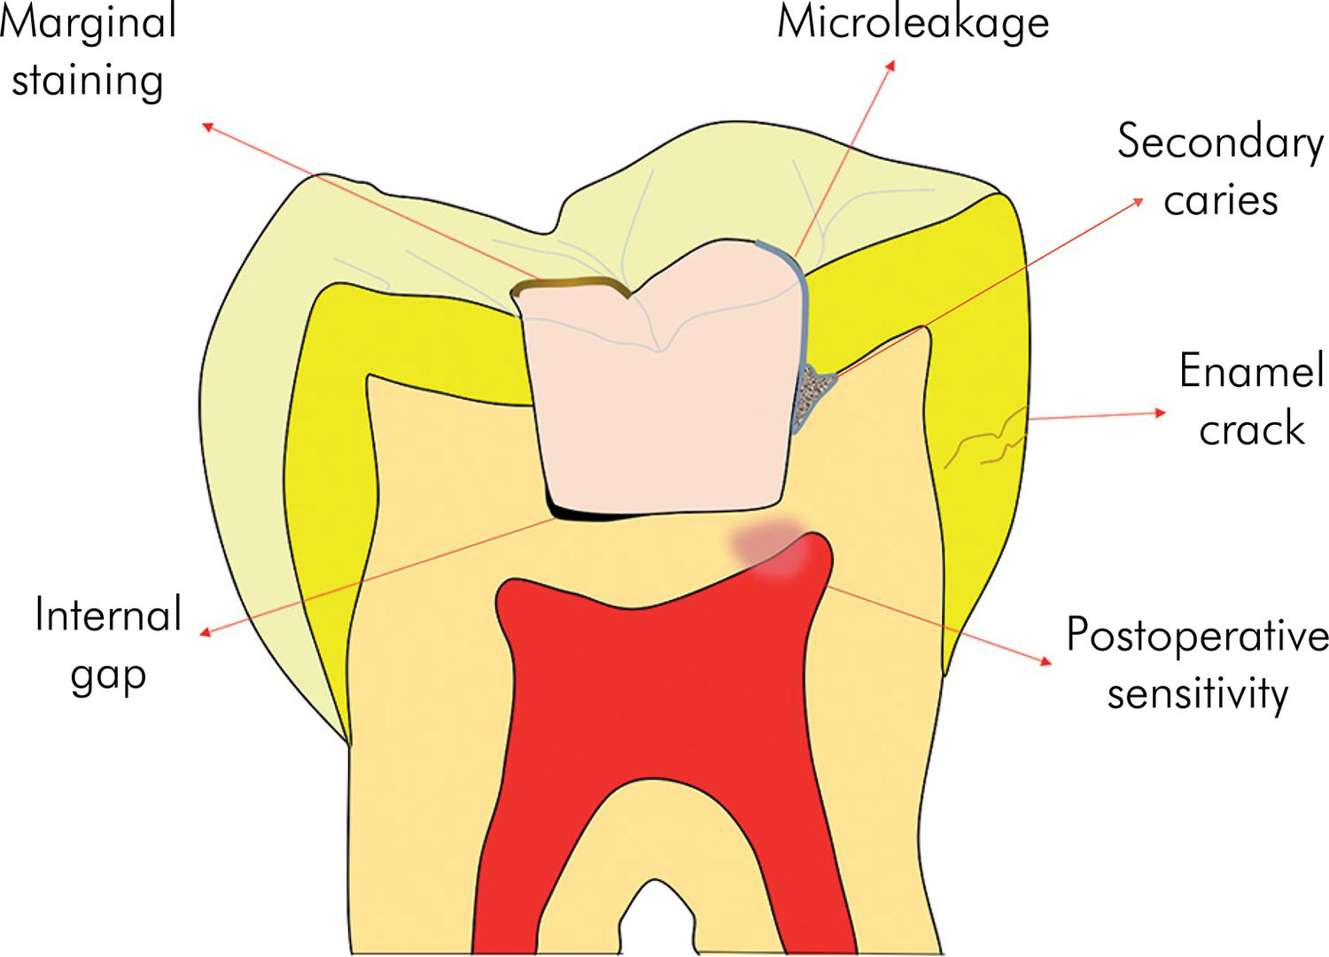
Introduction

Slide 3
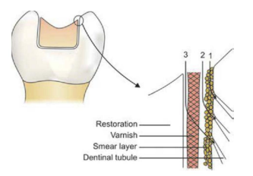
Within or via the smear layer.
Between the smear layer and the cavity varnish/ cement.
Between the cavity varnish/ cement and the restoration.

Slide 4
History
Fluid filtration method - Developed by Pashley’s group in 1987.
Silver staining technique - Wu and Cob demonstrated microdefects in composite resins.
45Ca - commonly used - Swartz in1959.
Acid peel technique – By Fusan et al.
Thermal cycling – By Fraser in 1929.

Slide 5
Optical coherence topography - In 1998 by Colston et al.
Calcium hydroxide techniqe – By Borrows.
Bacterial technique – By Ellis and Brown

Slide 6
Definition
Microleakage” is defined as the passage of bacteria and their toxins between restoration margins and tooth preparation walls.
Sturdevant’s Art and Science of Operative Dentistry - 7th edition
Flow of oral fluid and bacteria into the microscopic gap between a prepared tooth surface and a restorative material.
Phillips’ science of dental materials – 11th edition
Microleakage can be defined as 'the clinically undetectable passage of bacteria and bacterial products, fluids, molecules or ions from the oral environment along the various gaps present in the cavity restoration interface.
Textbook of Operative Dentistry , Vimal K Siikri – 4th edition.

Slide 7
Clinical implications of Microleakage
Discoloration/Staining of restortion
Sensitivity
Recurrence of caries
Failure of restoration
Wen Yu Shih. Microleakage in different primary tooth restorations. J Chinese Med Assos. 2016;(1):1-7.

Slide 8
Dentin permeability
It is theoretically directly proportional to the number of exposed tubules and their diameter, and is inversely proportional to dentin thickness.
Regional Differences
Occlusal coronal dentin has a very nonuniform permeability. The permeability is very high over pulp horns and very low in the center. This phenomenon is not due to differences in dentin thickness but is an intrinsic property of the dentin.
Edwina A. M. Kidd. Microleakage : a review. J Dent. 1976;5(4):199-205.

Slide 9
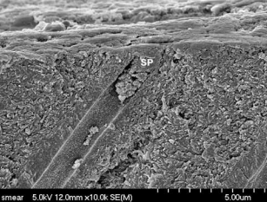
Role of Smear Layer
Whenever tooth structure is prepared with a bur or other instrument, residual organic and inorganic components form a “smear layer” of debris on the surface.The smear layer fills the orifices of dentin tubules, forming “smear plugs.
Smear layer is basically composed of hydroxyapatite and altered denatured collagen.
Sturdevant’s Art and Science of Operative Dentistry - 7th edition

Slide 10
Restorative materials and microleakage
Three properties of restorative materials that contribute largely to microleakage are:
i. Coefficient of thermal expansion
ii. Polymerization shrinkage
iii. Property of adhesion
Other properties like creep, elasticity, resistance to fatigue failures, solubility, etc. also contribute to a minor extent.
Textbook of Operative Dentistry , Vimal K Siikri – 4th edition.

Slide 11
Factors controlling microleakage
Dimensional change in tooth structure
Dimensional changes of materials due to polymerisation shrinkage
Mechanical stress
Absorption of water
Thermal contraction
Andrea fabianelli et al. The relevance of micro-leakage studies. Scientific. Inter Dent SA. 2003;3(9):64-74..

Slide 12
Methods to detect microleakage

Slide 13
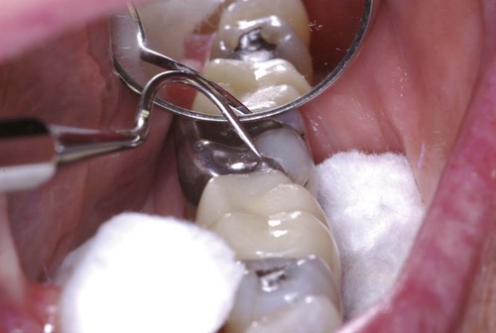
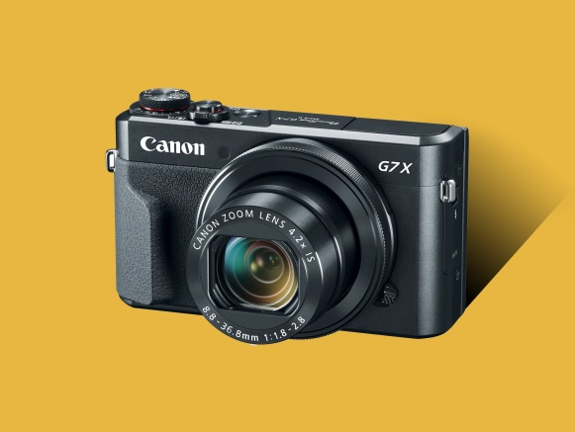
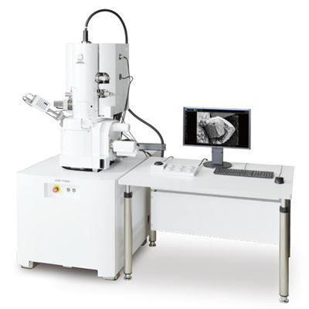
Direct observation
Gonzalez et al. Microleakage testing. Annals of Dentistry. 1997;1(4):3137.

Slide 14
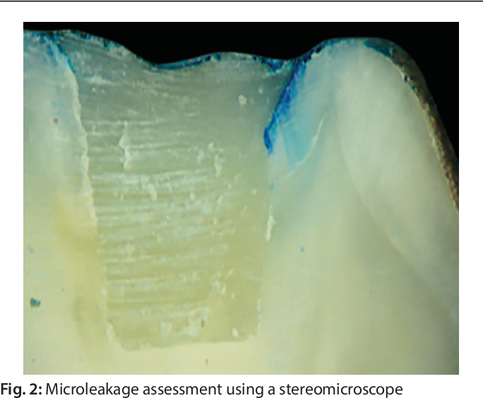
Dye Penetration method
5% eosin, 0.5-2% methylene blue, 0.5-1% black India ink, blue ink, black ink, drawing ink, Procion brilliant blue, 0.5% Rhodamine B, 0.5% fuchsin dyes
The teeth are sectioned longitudinally or transversely or cleared and the linear penetration of the dye is recorded either by longitudinal sectioning, transverse sectioning and clearing technique
Disadvantages
Random nature of selecting the cut axis.
Very low odds of the sections being cut through the deepest dye penetration point, resulting in underestimation of leakage and achieving unreliable data.
Microleakage assessment using steriomicroscope
Farnaz Jafari et al. Importance and methodologies of endodontic microleakage studies: A systematic review. J Clin Exp Dent. 2017;9(6):e812-9.

Slide 15
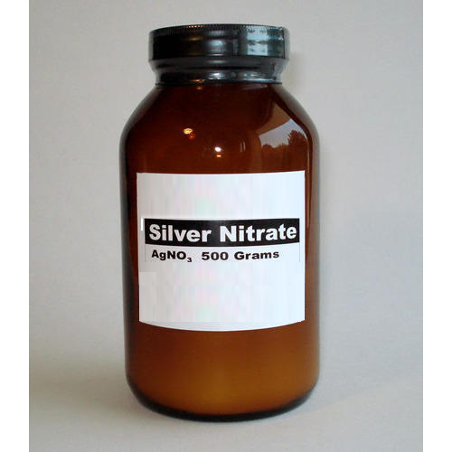
Chemical Tracers
The use of silver nitrate is second to the organic dyes in usage and used to demonstrate microdefects in composite resins.
This involves immersion of the specimens in a 50 percent solution of silver nitrate for two hours in the dark. The specimens are rinsed to remove silver ions on the surface, and then immersed in developing solution and exposed to Fluorescent light for six hours.
Occurred as a result of chemical reactions between components.
Limitations are similar to dye penetration methods.
Gonzalez et al. Microleakage testing. Annals of Dentistry. 1997;1(4):3137.

Slide 16
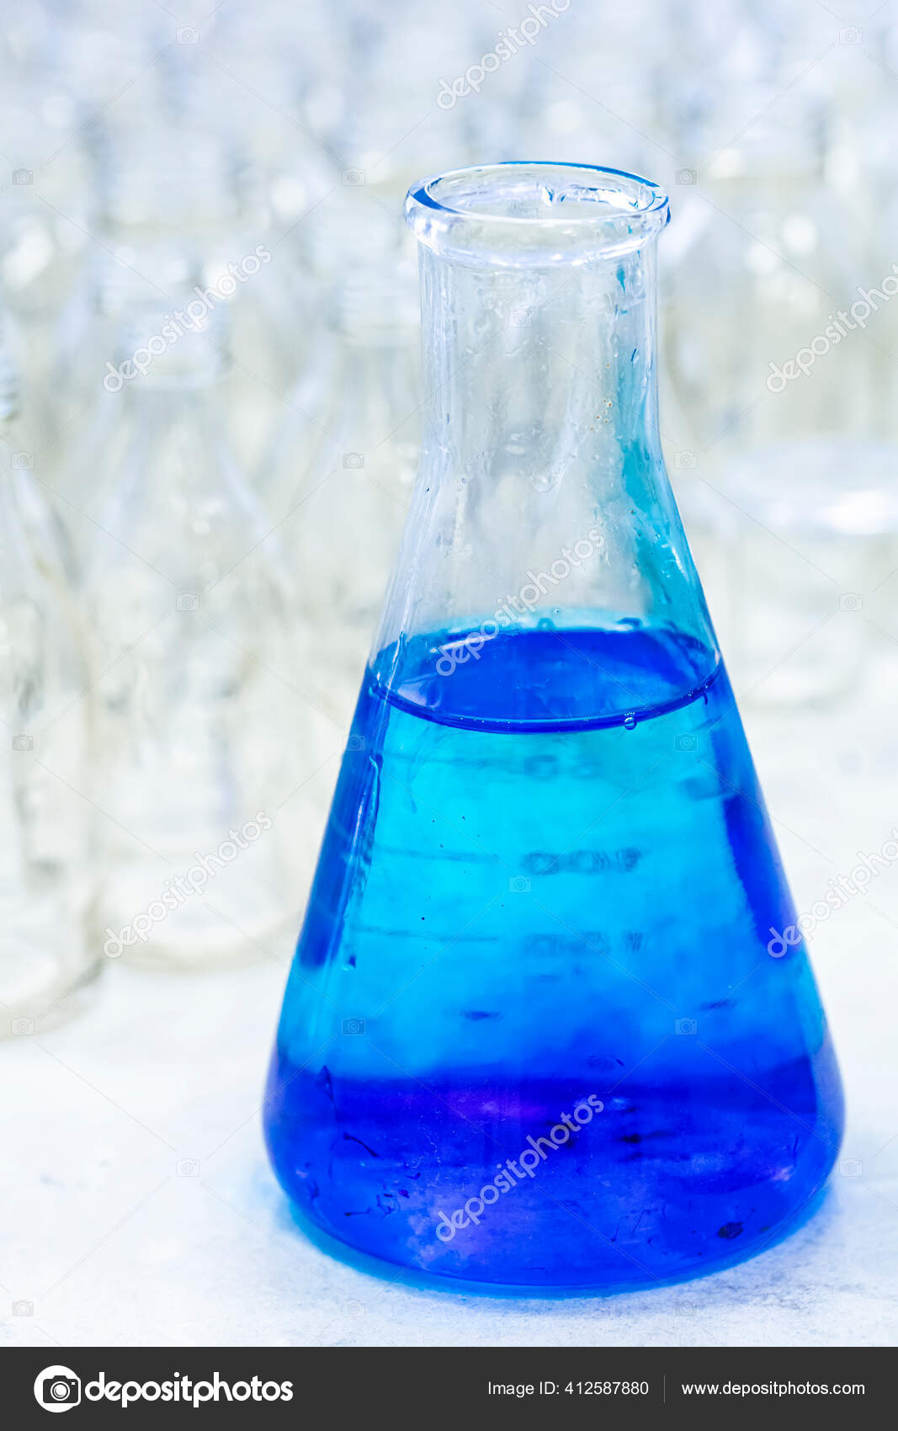
Dye Extraction or Dissolution Method
Dye extraction studies use dye penetration and samples stained using 2% methlene blue are stored in a hermetically sealed vial containing nitric acid with a concentration of 65% for three days.
The vials are centrifugated at high speed to separate gutta-percha debris from the extracted dye. The supernatant from each sample is then analyzed in an UV-visible spectrophotometer with concentrated nitric acid as the blank.
Sadullah KAYA et al. Comparison of Dye Extraction or Dye Penetration Methods to Quantitatively Determine Microleakage of Three Different Root Canal Sealers. Dentistry. 2011;1(2):1-5.

Slide 17
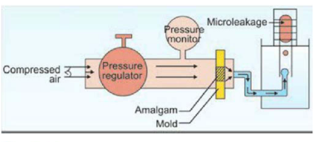
Air Pressure method
Compressed air was used to test the marginal seal of restorations in early 20th century.
Compressed air is introduced and the loss of pressure measured within a static system.
Microscopic examination of the release of air bubbles at the margins may in addition provide a subjective view of marginal integrity.
One advantage - tooth need not be destroyed.
Limitations
Inability to use in-vivo, does not represent the clinical situation and also does not take into account the drying effect of compressed air.
It is possible that some air may leak before it enters the tooth.
Device used to measure leakage at the amalgam mold interface.
Air leakage is measured in μm/min.
Gonzalez et al. Microleakage testing. Annals of Dentistry. 1997;1(4):3137.

Slide 18
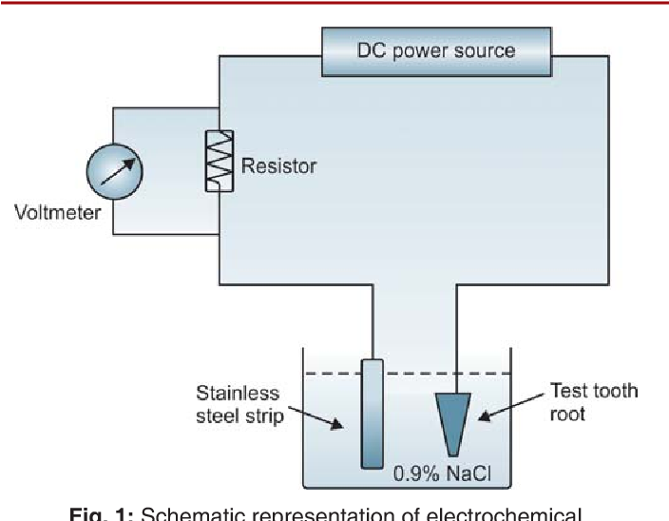
Electrochemical method
Insertion of electrode into extracted tooth - it contacts the base of restoration.
Once restored, the tooth is suitably sealed to prevent any electrical leakage through natural tooth structure and then immersed in an electrolytic bath.
A potential is applied between the tooth and the bath, and the leakage assessed by measuring the current flowing across a serial resistor.
Limitations
Unsuitability for metallic restorations.
Inability to use in in-vivo situations.
Gonzalez et al. Microleakage testing. Annals of Dentistry. 1997;1(4):3137.

Slide 19
Neutron Activation Analysis
Restored teeth soaked in an aqueous solution of non radioactive manganese salt.
Whole teeth were then placed in core of nuclear reactor; the 55Mn was activated to 56Mn and the X-ray emission of 56Mn formed during irradiation was measured.
The number of radioactive counts was proportional to the uptake of Mn per tooth.
Limitations
Teeth must be extracted for irradiation and analysis, the path and depth of tracer penetration was not well defined.
Experimental costs were high
Combined effort was required from nuclear engineers and dentists.
Edwina A. M. Kidd. Microleakage : a review. J Dent. 1976;5(4):199-205.

Slide 20
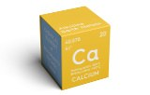
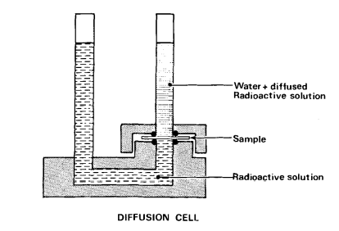
Radioactive Isotopes
⁴⁵Ca - commonly used.
A cross section of a filled tooth constitutes a diffusion barrier between two cells and the rate of transfer of a radio-labeled species from one cell to the other serves to give a measure of the amount of microleakage.
Such a method has the advantage of being adaptable to the long-term quantitative monitoring of microleakage.
Exposure time Radioisotope - two hours
Dye - 24 hours or longer.
Limitations
⁴⁵Ca, which have an affinity for the tooth or restorative material, may lead to misleading results.
Expensive and technique sensitive.
Gonzalez et al. Microleakage testing. Annals of Dentistry. 1997;1(4):3137.
Stephen Crisp et al. Radioactive tracer technique for monitoring of microleakage: An interim report. J Biomed Mat Res. 1980;(14):373-382.

Slide 21
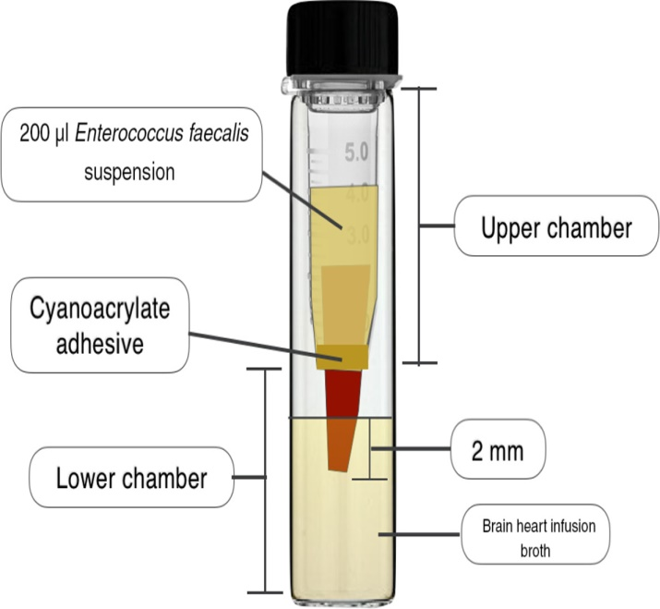
Bacterial studies
Systems comprise of two chambers and each enables apical and coronal extremities of each specimen to be completely separated.
The turbidity of broth in apical chamber is first indication of contamination by microorganisms.
If the pulp chamber is contaminated, it may serve as a reservoir of microorganisms and toxins resulting in failure of root canal treatment.
Limitations
Results are affected by strains of bacteria used.
This technique is not indicated for sealers with antimicrobial activity.
Mali sheetal et al. Methodologies for assessing root canal sealing: a review. IJOCR. 2015;3(3):55-58.

Slide 22
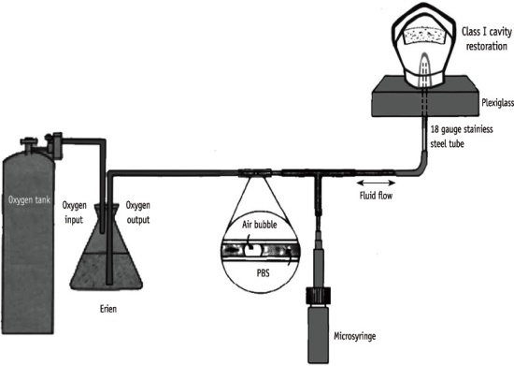
Fluid Filtration / Transport Method
Filled canal that has its coronal portion and apical portion connected to a tube filled with water under atmospheric pressure and its apex to a 20ul glass capillary tube 170 mm long and having uniform caliber filled with water.
Air bubble of 3mm is introduced to the open end of the capillary.
Fluid is conducted through the root filling by applying a pressure for 3 hours after an interval period of 24 hours. This is necessary for air bubble stabilization.
Mali sheetal et al. Methodologies for assessing root canal sealing: a review. IJOCR. 2015;3(3):55-58.

Slide 23
The fluid transport results were expressed in µl/min.
As the samples can be stored for long both apical and coronal seal can be assessed and the recordings are automatic.
Limitations:
It is not a standard method and there is a wide range in time (1-3 hours) and pressure (1-20psi) values.

Slide 24
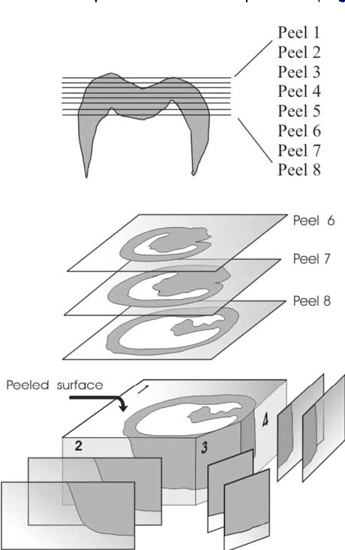
Acetate peel technique
Fusun et al. described the technique as a rapid method for preparing many sequential replicas from an etched tooth surface to study dental hard tissue.
Acetate films can be used to imprint the etched tooth surface at a micron scale resolution, which gives an overall view of the tooth structure and microleakage at the interface.
Mohapatra and Sivakumar reported that the acetate peel technique is a simple, inexpensive, and fast method for measuring microleakage. Moreover, peels are stable and can be preserved for further evaluation.
Limitation
Produce artifacts that can be misinterpreted.
AlHabdan AA. Review of microleakage evaluation tools.J Int Oral Health 2017;9:141-145

Slide 25
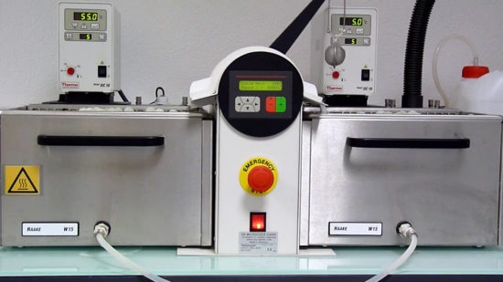
Thermal cycling
Extracted and filled teeth were immersed in iced water, dried and viewed under a binocular microscope.
As the teeth were warmed in the fingers, droplets of fluid were seen to exude from the margins of the restorations.
Amalgam, gold inlays, gold foil, silicate, gutta-percha, zinc oxide and eugenol and acrylic resin were all seen to leak in this manner.
Marginal percolation was caused by a difference in the coefficient of thermal expansion between the dental tissues and the restorative material and by thermal expansion of fluids occupying the crevice between tooth and restoration.
Edwina A. M. Kidd. Microleakage : a review. J Dent. 1976;5(4):199-205.

Slide 26
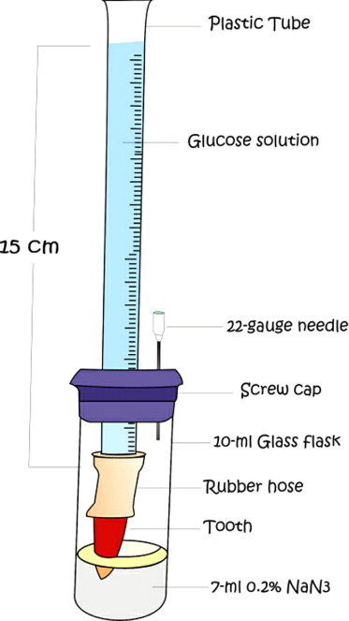
Glucose penetration model using fluid filtration
It relies on the filtration rate of glucose along the root canal obturation material
leakage is quantified with spectrophotometry.
Glucose - small molecular size (MW = 180 Da), nutrient for bacteria.
Therefore, if glucose penetrates into the root canal, the bacteria surviving multiply, causing periapical inflammation.
Limitations
The long experimental period.
Difficulty in maintaining a bacteria-free system to prevent consumption of glucose and the risk of water evaporation.
Farnaz Jafari et al. Importance and methodologies of endodontic microleakage studies: A systematic review. J Clin Exp Dent. 2017;9(6):e812-9.

Slide 27
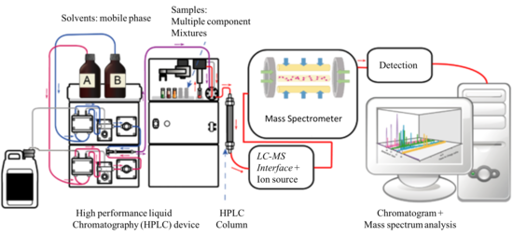
Caffeine microleakage test
Another method with the use of a modified dual-chamber model.
Epoxy resin is used for sealing of the margins instead of cyanoacrylate glue and leaked caffeine content can be detected by high-performance liquid chromatography-tandem mass spectrometry (HPLC-MS/MS) or a visible ultraviolet spectrophotometer(UV-VIS).
The caffeine detection limit was 2000 ng mL-1, using UV-VIS, and 10 ng mL-1, using HPLC-MS/MS.
HPLC-MS/MS can detect concentrations at least 1000 times lower.
Farnaz Jafari et al. Importance and methodologies of endodontic microleakage studies: A systematic review. J Clin Exp Dent. 2017;9(6):e812-9.

Slide 28
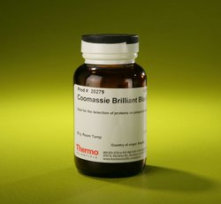
Protein microleakage test
Carried out using bovine serum albumin in a dual-chamber apparatus and calculated using a spectrophotometer.
Methodology:
Bovine serum albumin marker is traced in a dual-chamber apparatus with Bradford indicator which is used to determine the concentration of albumin leaking from the upper chamber into lower chamber.
The procedure relies on the formation of a complex between the dye, Brilliant Blue G, and proteins in solution.
Protein-dye complex shifts the wavelength of maximum absorption of Coomassie Brilliant Blue G from 465 to 596 nm.
The absorption rate is proportional to the protein present.
Farnaz Jafari et al. Importance and methodologies of endodontic microleakage studies: A systematic review. J Clin Exp Dent. 2017;9(6):e812-9.

Slide 29
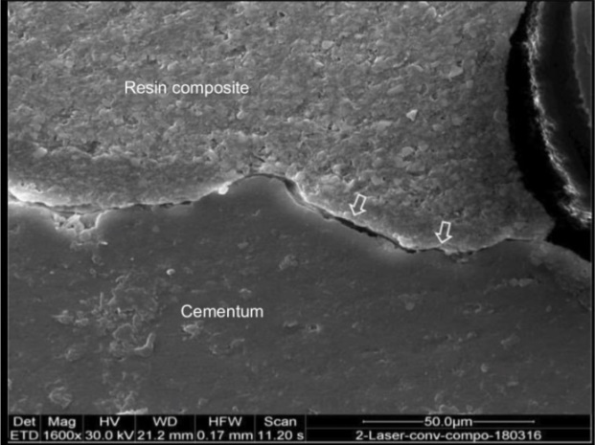
Microscopic Examination
Scanning electron microscopy
It provides a means of direct visual observation of the adaptation of restorative materials to cavity margins.
Impressions of the restorations of the replicas were made after thermomechanical loading and analysed with SEM at 200x magnification using computerized analysis program.
Continuous margins were defined as having no gaps, irregularities or fractures.
Limitation
Potential to induce artifacts during specimen preparations.
Seigward D. Heintze. Floroscence microscopy for the evaluation of class V restorations in-vitro. J Adhes Dent. 2005;1(7):19-28.
Edwina A. M. Kidd. Microleakage : a review. J Dent. 1976;5(4):199-205.

Slide 30
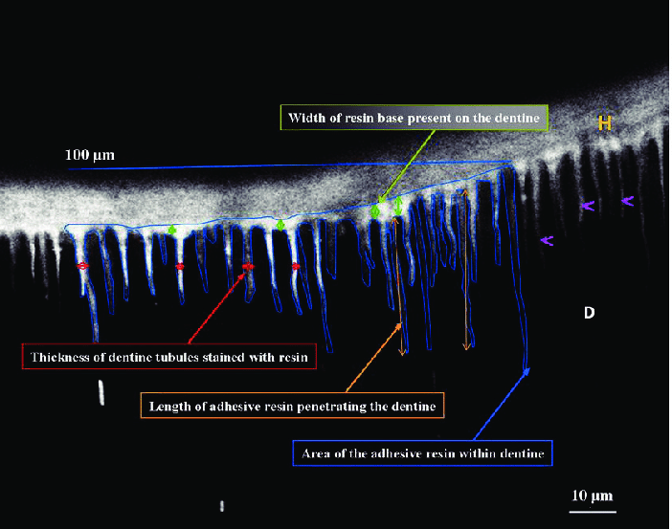
Confocal laser scanning microscopy
To detect subsurface structures up to 100 μm without sample destruction.
Tangsgoolwatana et al. compared the degree and pattern of microleakage in bonded amalgam restorations treated with fluorescent dyes and a 45 Ca radioisotope using CLSM and autoradiography, respectively and reported a high correlation between the results indicating that these two microleakage methods can be directly compared.
Grobler et al. stated that CLSM could detect resin tag formation, penetration of the bonding agents deep into the tubules, and hybrid layer formation for any bonding material.
AlHabdan AA. Review of microleakage evaluation tools.J Int Oral Health 2017;9:141-145

Slide 31
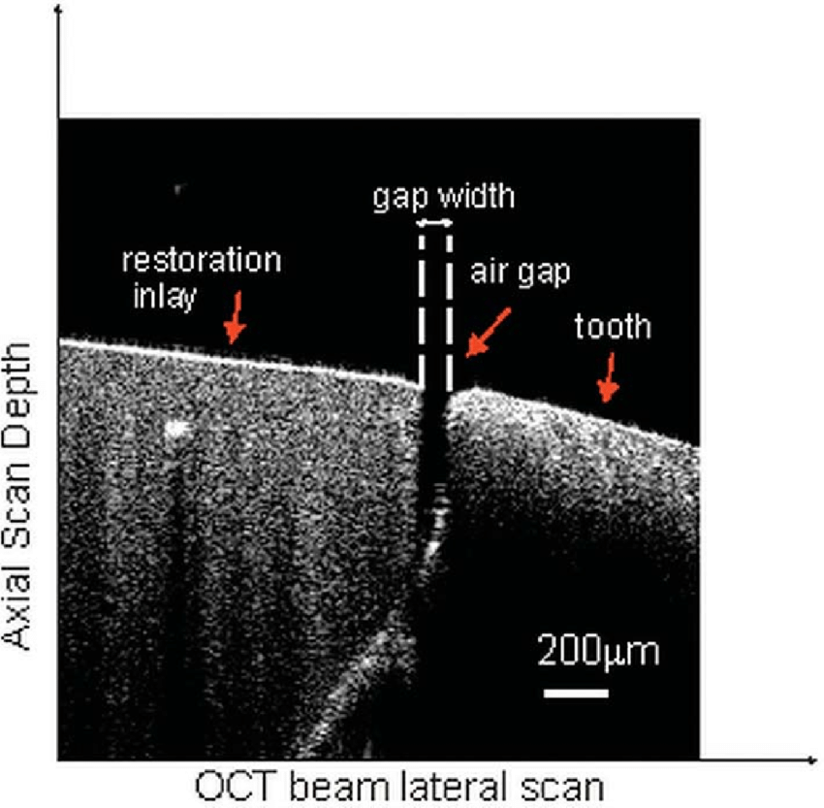
Optical coherence tomography
Introduced in 1998 by Colston et al. to evaluate dental tissues in pigs. .
Produces 3D images for the qualitative and quantitative evaluation of dental hard and soft tissues in vivo.
OCT clinically evaluates dental restoration margins intraorally and can be used to quantify bubbles and voids within composites and most dental restorations by detecting the reflection of infrared light waves from internal microstructures, similar to the ultrasonic pulse echo method.
It can detect enamel cracks at the margins of composite restorations noninvasively.
AlHabdan AA. Review of microleakage evaluation tools.J Int Oral Health 2017;9:141-145

Slide 32
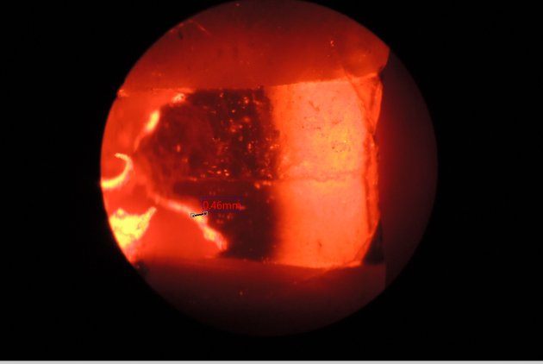
b. Fluorescent Microscopy
Dentinal and enamel margins were evaluated with a magnification of 20x with an exitation filter of BP 350-460.
Samples were dried with compressed air and marginal irregularities were defined as zone of increased fluoroscence activity (White lines) and continous margins as not showing this phenomenon.
By means of surface analysis program the percentage of continious margin of the entire length of enamel and dentin margin were calculated.
Seigward D. Heintze. Floroscence microscopy for the evaluation of class V restorations in-vitro. J Adhes Dent. 2005;1(7):19-28.

Slide 33
Miscellaneous
CALCIUM HYDROXIDE TECHNIQUE
It was developed for possible use in vivo.
Borrows suggested the use of a suspension of calcium hydroxide in deionized water as a leakage detection agent. He demonstrated that, after thermocycling, the pH of the margin of acrylic restorations with pure calcium hydroxide base in a suspension of deionized water increased to 8.0.
A change in color from yellow to dark purple was recorded as a positive result.
Animal experiments
Animal studies on dogs undergoing endodontic treatment with a minimum 8 months of follow-up is another technique, with radiographs being taken every 2 months and histologic examinations after completion of the follow up period .
More extensive studies are necessary for efficient system for microleakage studies.
Gonzalez et al. Microleakage testing. Annals of Dentistry. 1997;1(4):3137.

Slide 34
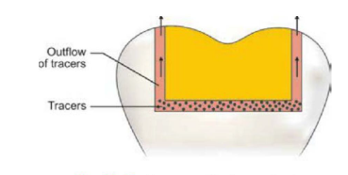
Reverse Diffusion Method
This method involves placing a certain amount of tracers on the cavity floor prior to insertion of the restorative material.
After a stipulated period of time the tooth is immersed in a definite volume of the medium. The amount of the tracers which leaks into the medium is measured.
Modified by using calcium hydroxide in place of tracers at the base of the cavity.
Textbook of Operative Dentistry , Vimal K Siikri – 4th edition.

Slide 35
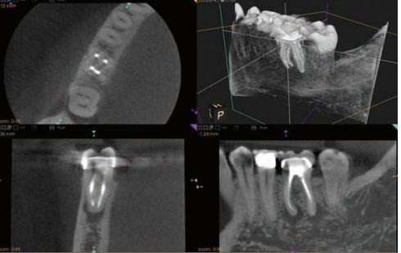
Three-dimensional Methods
Three-dimensional method CBCT and SEM evaluation can be used for evaluation of maximum and minimum amounts of voids and dentin diffusion of sealer in obturation materials and can be representative of leakage potential of endodontic materials.
Bond strength, push-out bond strength and bond durability (92) can reveal leakage potential of endodontic materials.
Farnaz Jafari et al. Importance and methodologies of endodontic microleakage studies: A systematic review. J Clin Exp Dent. 2017;9(6):e812-9.

Slide 36
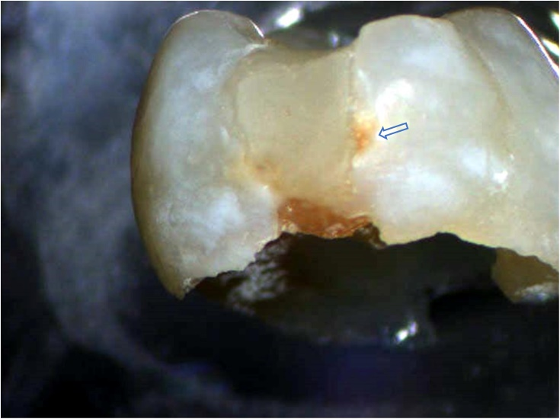
Laser Microspectral Analysis
Device consists of an infrared pulsed laser, usually with ruby or neodimium doped glass as active medium.
The radiation produced by the discharge is focused to the input slit of spectrophotometer which will give the emission spectrum of the atoms contained in the plasma.
It gives the possibility to measure the infiltration of dye substances in the porous regions of filled tooth.
Textbook of Operative Dentistry , Vimal K Siikri – 4th edition.

Slide 37
Artificial caries
Produced in vitro using either bacterial cultures or a chemical system-the acidified gelatin gel technique developed by Silverstone.
Ellis and Brown used a bacterial technique to produce artificial caries at the interface of the amalgam restoration and the tooth. Thus they linked the development of carious lesions with microleakage, but they did not describe the histological features of the lesions that they produced.
Lesions in polarized light: an ‘outer’ lesion and a ‘cavity wall’ lesion. The outer lesion showed the features of primary attack, while the cavity wall lesion was formed by microleakage of ions from the acidified gelatin gel into the restoration dental tissue interface.
Edwina A. M. Kidd. Microleakage : a review. J Dent. 1976;5(4):199-205.

Slide 38
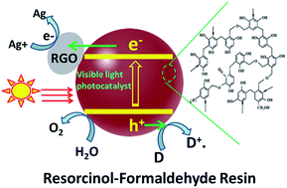
Resin Infiltration Method
The specimens are coated with nail polish and immersed in resorcinol formaldehyde resin of 5 days at 4.0°C and allowed to polymerize for four days
The nail polish removed and are embedded in epoxy resin and sectioned horizontally.
Cross-sections are transilluminated and viewed at magnification of 25 x with stereomicroscope. The photographs are taken for image analysis.
Textbook of Operative Dentistry , Vimal K Siikri – 4th edition.

Slide 39
COMPARATIVE STUDIES

Slide 40
According to Saeed Morandi et al. Both fluid filtration and bacterial leakage techniques showed same results and there was no significant difference between both in assessment of apical microleakage.
Acoording to Salsabila Yufa et al. there was no difference in accuracy between conventional and digital indirect periapical radiographic techniques in detecting marginal macroleakage but there is significant difference in the measurement capability regarding radiopacity levels between the two methods, with the digital approach demonstrating higher analytical power.
Moradi S, Lomee M, Gharechahi M. Comparison of fluid filtration and bacterial leakage techniques for evaluation of microleakage in endodontics. Dent Res J (Isfahan). 2015;12(2):109-114.
Yufa S, Shantiningsih RR, Suryani IR. Marginal microleakage detection and radioopacity measurement under restoration with conventional and digital radiography. J Dent Indones. 2019;26(2): 60-64

Slide 41
According to Fabio Augusto de Santi Alvarenga et al. Visual (stereo micro scope) and digital methods (ITS) showed high levels of intra- and inter-examiner reproducibility when marginal microleakage was assessed.
According to L A Mueninghoff et al. The dye penetration method continued to record microleakage after the pH paper had ceased to detect hydroxyl ions. The dye penetration method appeared to be more dependable as the age of the restoration increased.
de Santi Alvarenga FA, Pinelli C, Monteiro Loffredo Ld. Reliability of marginal microleakage assessment by visual and digital methods. Eur J Dent 2015;9:1-5.
Mueninghoff LA, Dunn SK, Leinfelder KF. Comparison of dye and ion microleakage tests. Am J Dent. 1990 Oct;3(5):192-4. PMID: 2076248.

Slide 42
Sadullah Kaya et al volumetric determination of dye penetration method were not different when compared with the tests of dye extraction methods with vaccuming. In simplifying he procedures, dye extraction methods may be preferred.
Wendt et al determined the effect of thermocycling on dye penetration in the in vitro assessment of microleakage composite resins. There was no increase of microleakage in restorations when thermocycling was used.
Sadullah KAYA et al. Comparison of Dye Extraction or Dye Penetration Methods to Quantitatively Determine Microleakage of Three Different Root Canal Sealers. Dentistry. 2011;1(2):1-5.
Gonzalez et al. Microleakage testing. Annals of Dentistry. 1997;1(4):3137.

Slide 43
Beril Karagenc et al. There is poor correlation between fluid filtration, Electrochemical, Bacterial leakage and Dye leakage tests to evaluate hydraulic leakage. The clinical significance of leakage in-vitro is questionable.
Almeida et al. Rhodamine B detected more microleakage than ⁴⁵Ca or methylene blue and ⁴⁵Ca generally detected more microleakage thn methylene blue.
Beril Karagenc et al.A comparision of four different microleakage tests for assesment of leakage of root canal fillings. Oral Surg Oral Path Oral Rad Endod. 2006;1(102):110-113.
Almeida et al. Three different methods to evaluate microleakage of packable composites in class II restorations. Oper Dent;(2):453-460.

Slide 44
CONCLUSION
Different microleakage testing methodologies are available to researchers which have their own advantages and disadvantages. Efforts are being made to make the testing clinically relevant as in-vitro results do not necessarily reflect the clinical performances.
So, Clinicians should adopt these technologies and use them in the most predictable and efficient way possible so that prevention of microleakage paves the way for more predictable and successful endodontic outcomes.

